Slide 1
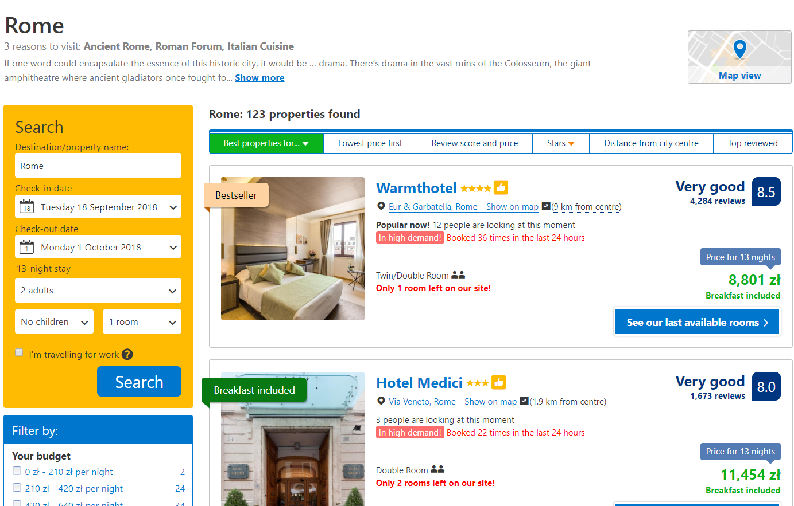
Bad interface – Booking.com
Too much informations
Too many colours
Too many highlighted details
Too much of everything – vogue, unclear page

Slide 2
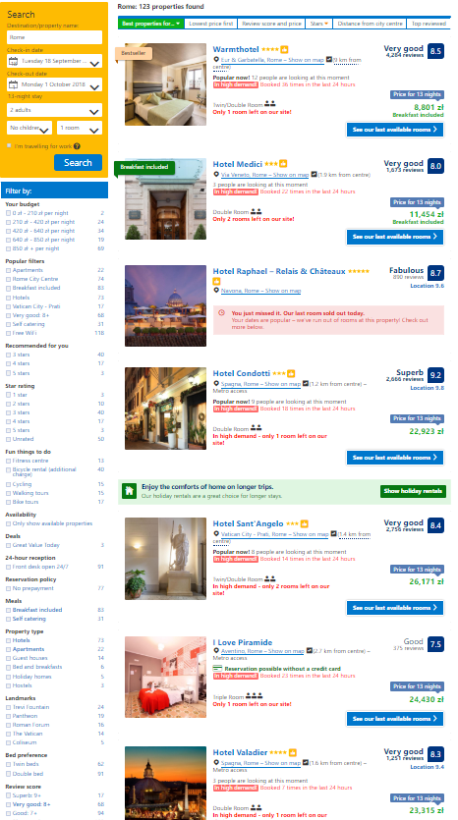
Bad interface – Booking.com
Filters are like self explenatory

Slide 3
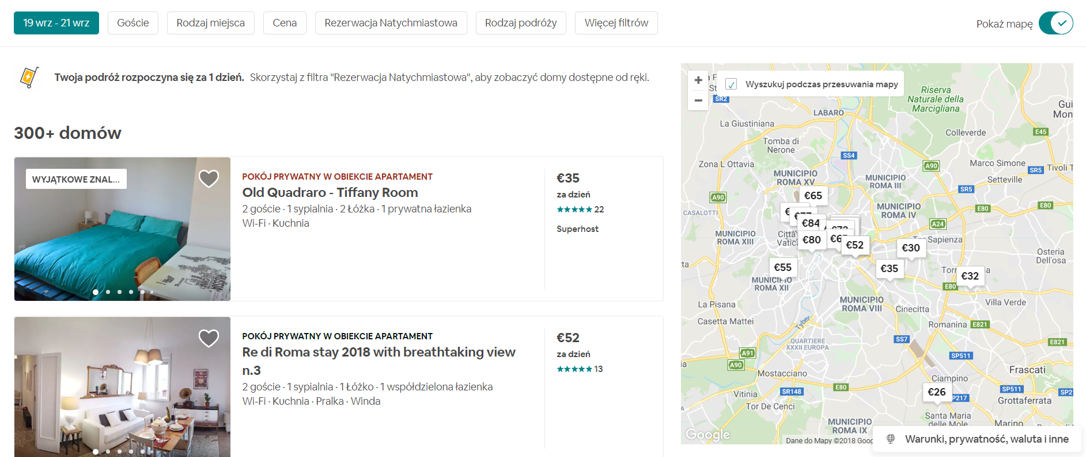
Good interface – Airbnb.com
Everything is clear from first glance.
Filters are hidden, you don’t have to care about them if you don’t want to.
Overall page feels consise, and modern.

Slide 4
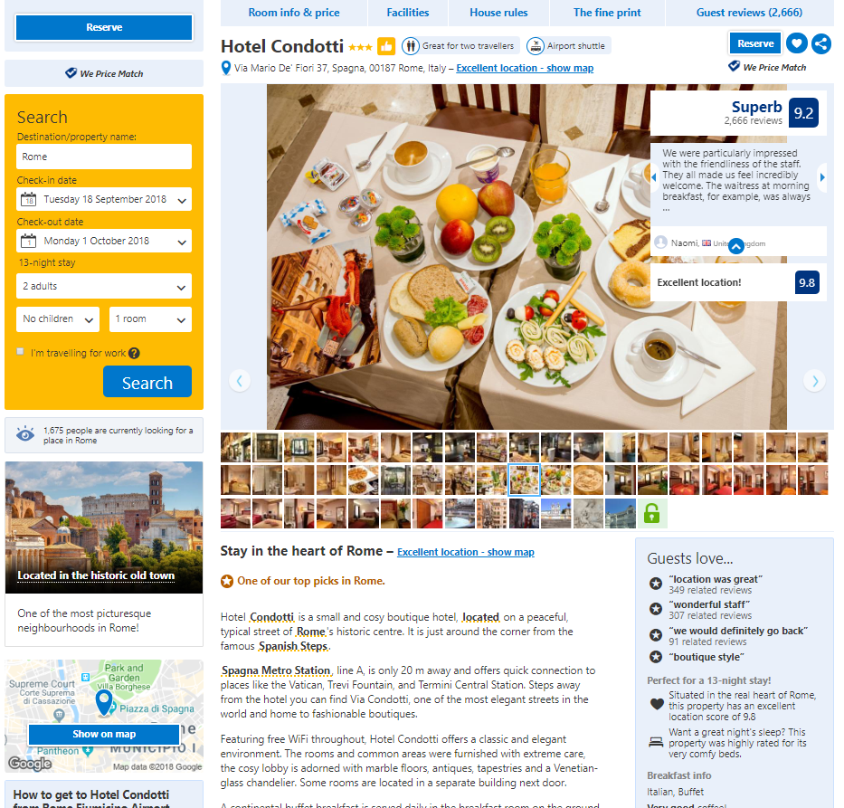
Bad interface – Booking.com
So many pictures, colours, details Overall 3 reservation buttons, which behave diffrently

Slide 5
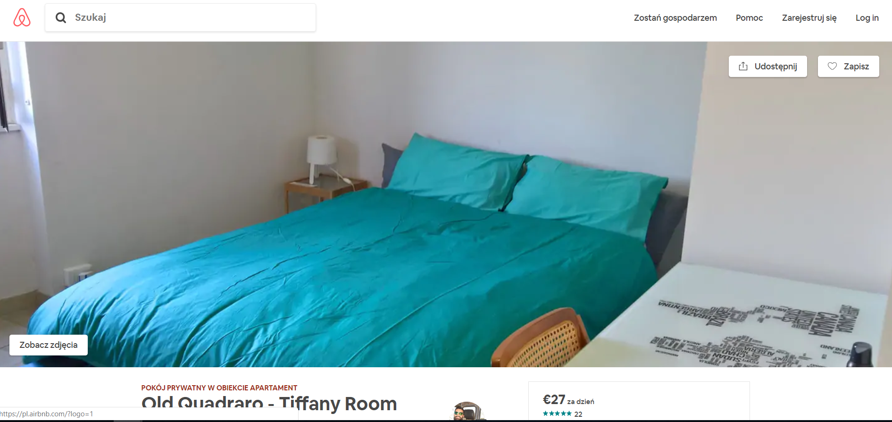
Good interface – Airbnb.com
No need to dig through all pictures. If I want to see more of them, there is appropriate, visible button to do so.

Slide 6
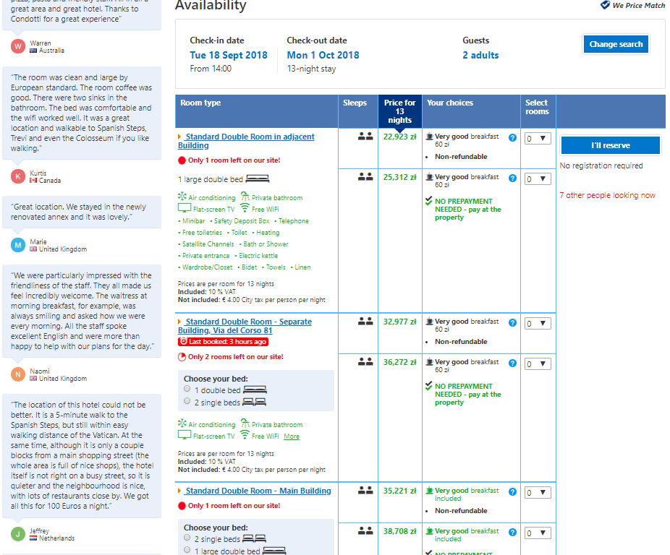
Bad interface – Booking.com
So many pictures, colours, details Overall 3 reservation buttons, which behave differently
Page seems to be really chaotic and not enjoyable at all.
It just makes trip a torment just from the beginning

Slide 7
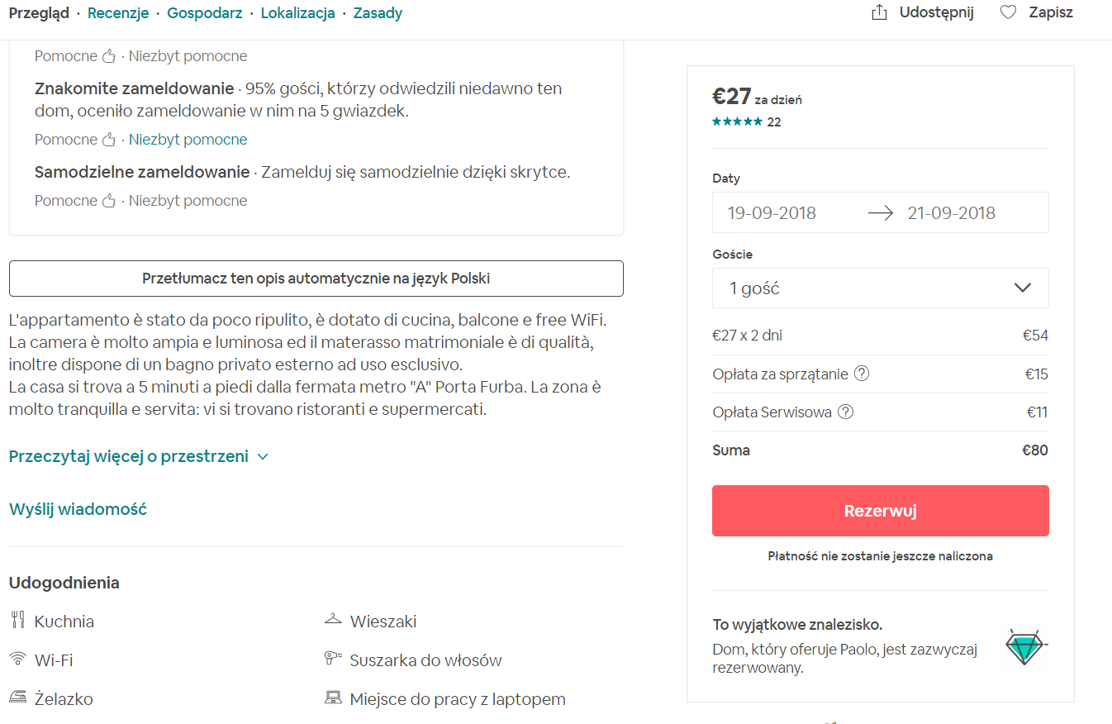
Good interface – Airbnb.com
Only headers are in different colour.
Everything is clear, and page is well organized

